Slide 1

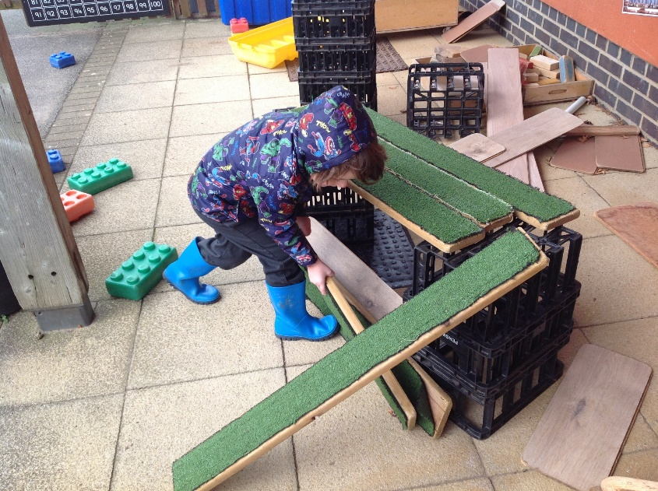
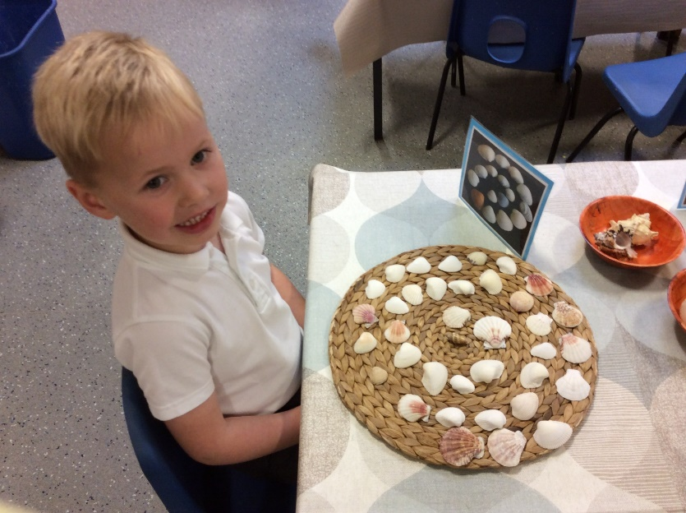
Parent Information Session
Academic year
September 2020-July 2021

Slide 2

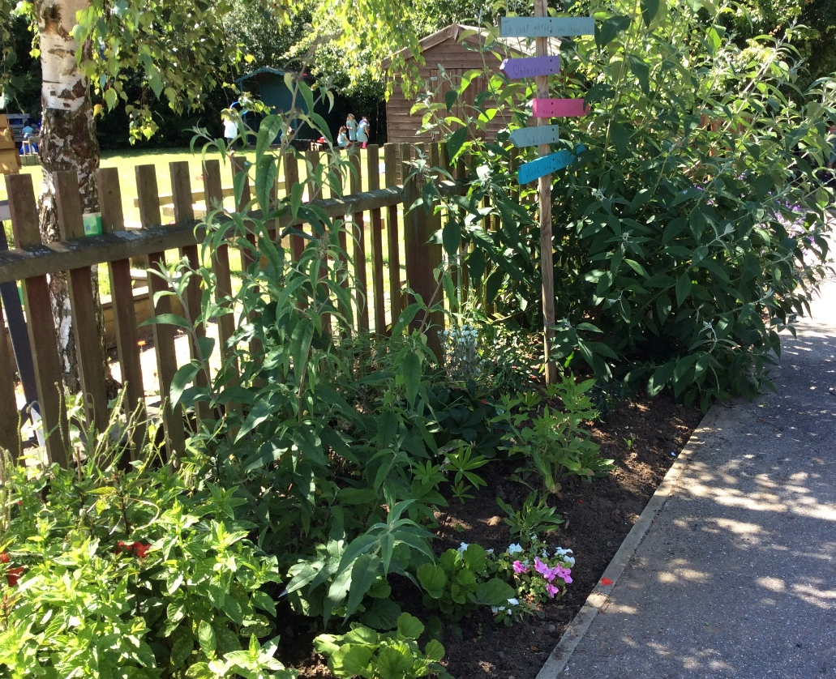
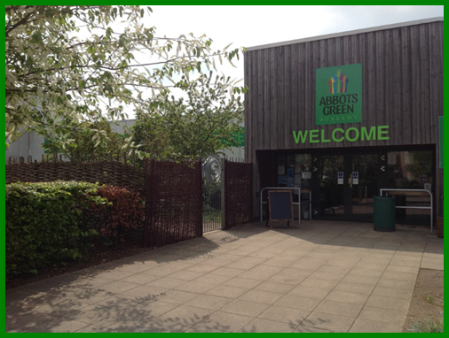
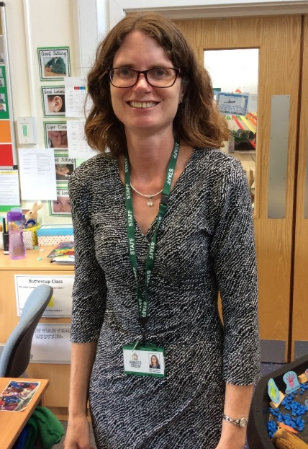
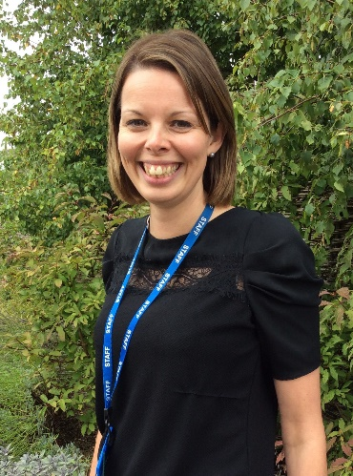


Slide 3

What does it mean to be part of Abbots Green?
We are all part of Abbots Green.
Every day we come together and grow as individuals.
We challenge ourselves and celebrate successes as we create our pathway for the future.
This is us!

Slide 4

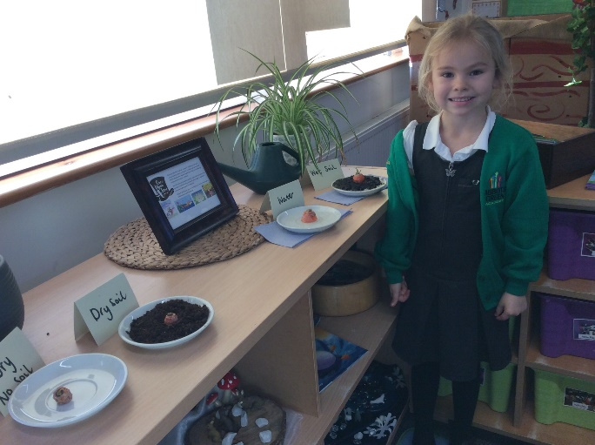
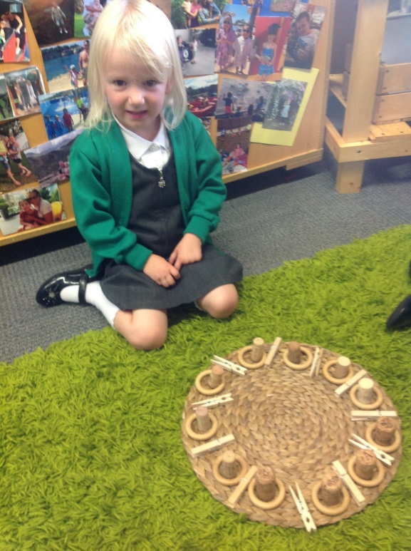
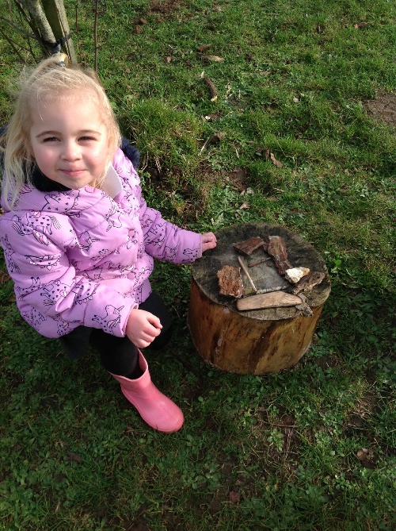
Abbots Green Academy
Our aims from this presentation are to:
Explore the Early Years Foundation Stage Curriculum.
Explain our routines in Reception.
Give a more informed understanding of starting school at Abbots Green.
Answer any questions you may have.?

Slide 5
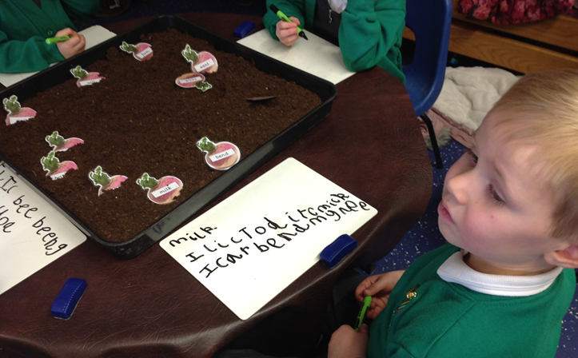

The Early Years Foundation Stage Curriculum (EYFS)
7 Areas of Learning and Development
Prime Areas
Personal, Social and Emotional Development
Making relationships Self-confidence and self-awareness
Managing feelings and behaviour
Physical Development
Moving and handling Health and self-care
Communication and Language
Listening and attention Understanding
Speaking
Specific Areas
Literacy
Reading Writing
Mathematics
Numbers Shape, space and measure
Understanding the World
People and communities
The world Technology
Expressive Arts and Design
Exploring and using media and materials
Being imaginative
Notes:
7 areas- Divided into Prime and specific.
It is not possible to achieve the specific areas until the prime areas are achieved.
E.g. until fine motor skills are developed in physical development – children will find it hard to progress in writing hard with holding a pencil (literacy)
The same with CL, unless they are developed in their speaking and understanding skills, they wont be able to progress in reading and writing.
Lots of activities are based on those prime skills initially. Talk about the picture and how it covers all the Prime Areas and could cover specific depending on observation.

Slide 6
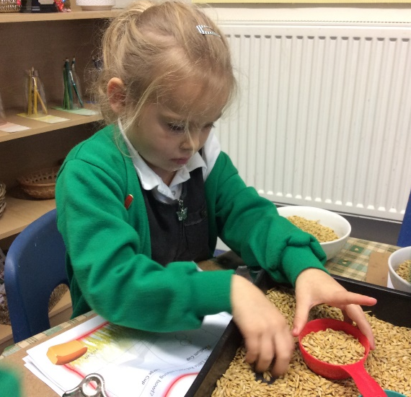
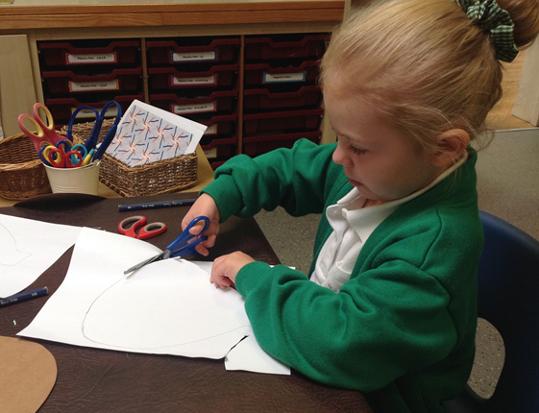
Characteristics of Effective learning
Playing and Exploring (engagement)
Finding out and exploring
Playing with what they know
Being willing to ‘have a go’
Active Learning (motivation)
Being involved and concentrating
Keeping on trying
Enjoying achieving what they set out to do.
Creating and thinking critically (thinking)
Having their own ideas
Making links
Choosing ways to do things.
Notes:
A new element in the revised EYFS (2012). They look at how children learn rather than what children are learning.
Children are all unique and learn in different ways and all have different interests, so knowing how each child learns and their interests helps us in our planning.

Slide 7
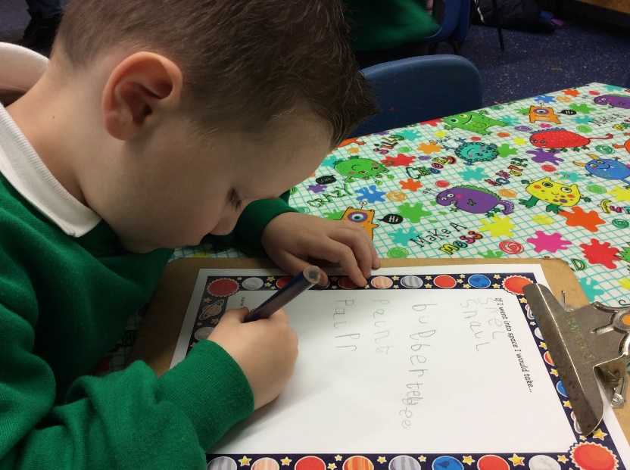
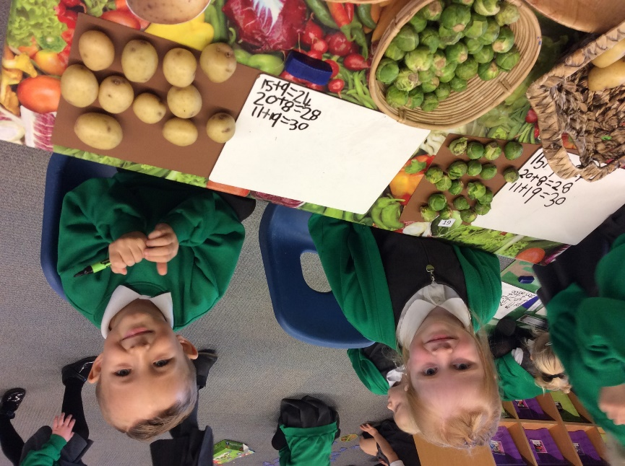
Topic Approach to Learning
Autumn Term – Jolly Journeys
Spring Term – Once Upon a Time
Summer Term – From a little seed
Notes:
In Early Years we follow a project approach to learning but also go with the children's interests. We chat with them at the beginning and find out what they know and what they want to find out. For example a previous project ‘Fly me to the Moon’ – children knew about rockets and astronauts but wanted to find out more about exactly who went to the moon and how (Neil Armstrong). This also led to the children planning an Alien Tea Party which parents were invited to. Children made invites, the food, set the tables etc.
Project day – spaceships
Children learn far more when interested and where it relates to real life.

Slide 8
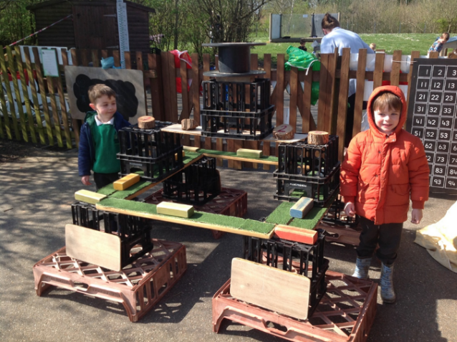
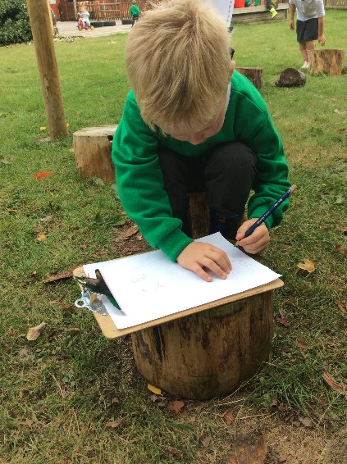
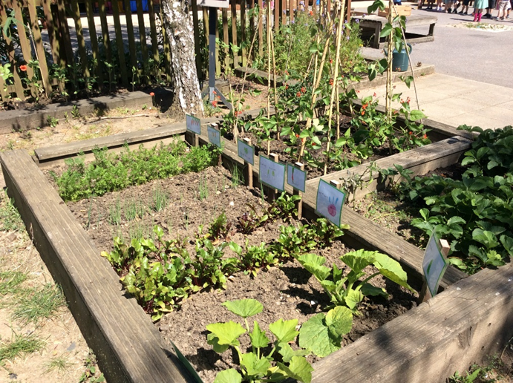
The Importance of Play
‘In their play children learn at their highest level.’
(Revised Early Years Foundation Stage)
Our Early Years curriculum at Abbots Green:
is all about our children learning through play and having time to explore and investigate the learning environment
is focused on children’s interests and next steps
involves daily ‘discover and do’ sessions.
ensures that children can learn at activities and can talk about their learning.
Notes:
Quote is from the EYFS curriculum – importance of learning through play. Children take part in both Adult led and child led activities and are all play based and cover the 7 areas of learning. Children have daily opportunities to work with adults in small group activities, and the rest of the time are learning through their play.
Children will say that they have just played all day – this is ok!

Slide 9
A day in the life of a child in reception
8.45am | Arrival at school
8.50am | Registration
9.00am | Mathematics
10.00am | Phonics
10.30am | Playtime
10.45am | Snack time
11.00am | Literacy
11.50am | Lunch
1.00pm 3.00pm | ‘Discover and Do’
3.00pm | Assembly / Story
3.30pm | School finishes
The daily routine is gradually introduced over the first term and all children are supported by staff during each transition time throughout the day.
Notes:
Inc balance of adult led activities, carpet time intro, phonics - Promote Autumn parents session.
Morning routine: Remind parents where to drop off/pick up. Children need to line up in classes.
To promote children’s independent skills we ask they do come in on their own asap – we will send a letter out regarding this in the new term.
Explain daily routine, literacy, maths, phonics and ‘Discover and Do’ sessions
The school day at Abbots Green begins promptly at 8.50am and ends at 3.30pm. If your child arrives between 8.50 and 9.05am they are classed as late and will need to be signed in at the main office. If your child arrives after 9.05am he/she will be marked as absent (unauthorised) unless an acceptable reason is given. Please ring the school if your child will not be arriving on time. See ‘How and when to contact the school’ for more information.
Talk about expectations of what chd do when they come into school – self register and sit down on carpet.
PE – days to be confirmed in Sept. However, these can sometimes change week to week, so chd always need P.E kit in school. Reminder about earrings etc. P.E kit.
OPEN door policy: At Abbots Green we operate an open door policy and you are encouraged to discuss any questions or queries with us.
Contact child’s class teacher in first instance.
Mornings are a very busy time so only quick messages at this time of day
After school is a better time to speak in more detail with your child’s class teacher. However, please respect that you may have to make an appointment/wait until a more appropriate time that day or week if your child’s teacher is busy.
If you would like a specific time to discuss a query or concern with the teacher or Mrs Morrison, please make an appointment via the school office.

Slide 10
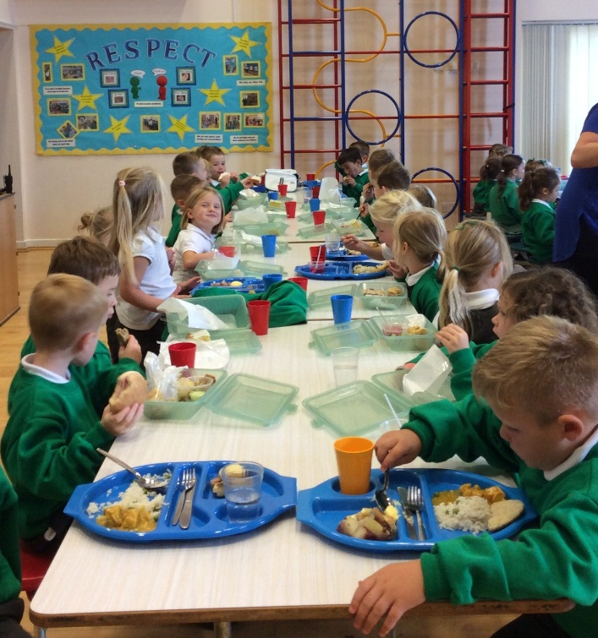
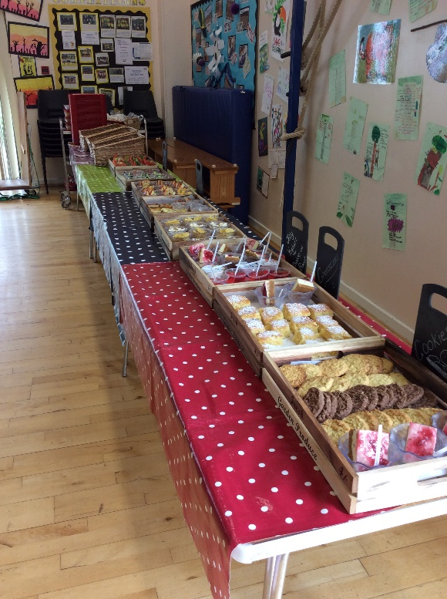
Play times and Lunch times
What time is lunchtime?
What can my child eat at lunch time?
Where will my child eat their lunch?
Notes:
Packed lunch should be healthy as we are a healthy school....children encouraged to eat sandwiches, fruit, yogurt etc. No whole bars of chocolate, or sweets e.g. Dairy Milk, Harribos but Animal Biscuits are acceptable. However, Pick and Mix option offers this.
time of lunch time, eat in dinner hall with class, price of lunch and when to pay, a bit about team of supervisors at lunch time
Free school meals will be available for all YR/Y1/Y2 children. (As of Sept 14). Government initiative. More info regarding this will be sent out to all parents later this term. Pick and mix and hot meals
On 20th July Transition session children will be able to stay for a lunch free of charge. They can choose a pick and mix or hot dinner.
Playtimes – when children go out to play with rest of school....

Slide 11
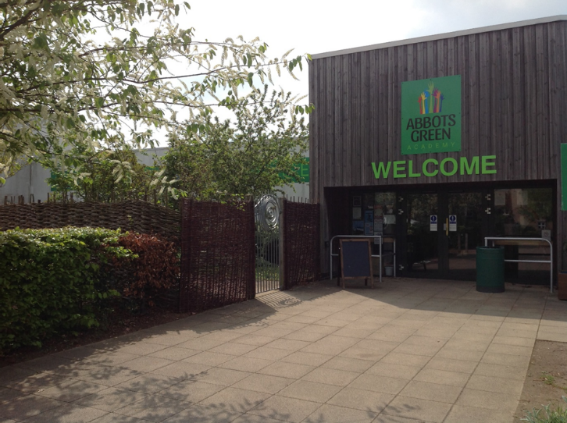
What to do if your child will be absent from school
Authorised and Unauthorised absence
What should I do if my child is ill or has a medical appointment?
How do I inform the school if our family is planning a holiday?
Notes:
Authorised – illness, medical appointment that can be proven, exceptional circumstances can be authorised.
Unauthorised – holidays unless you can provide evidence from your employer that you cannot take holiday at any other time e.g Forces. Holiday requests must be in writing to HF.
Illness – phone school on first day of absence. Letter about absence on return e.g. Chicken pox- no need to call every day.
Attendance is monitored very carfefully by Education Welfare Officers – please dont think we are being nosy if we ask you for more info – but we have to prove our attendance and absence. Please bear in mind the impact that absence has on a child’s learning and progress.
Reminders about rise and shine breakfast and 10-20 after school clubs Rise & Shine starts at 8am. 10-20 currently ends at 4.30 – contact Nic Hubbard for more info or look at our school website.
Making sure details are up to date – and make sure return all forms,

Slide 12
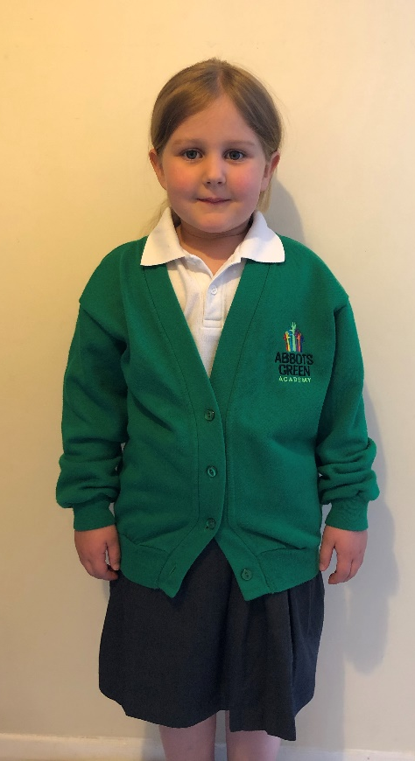
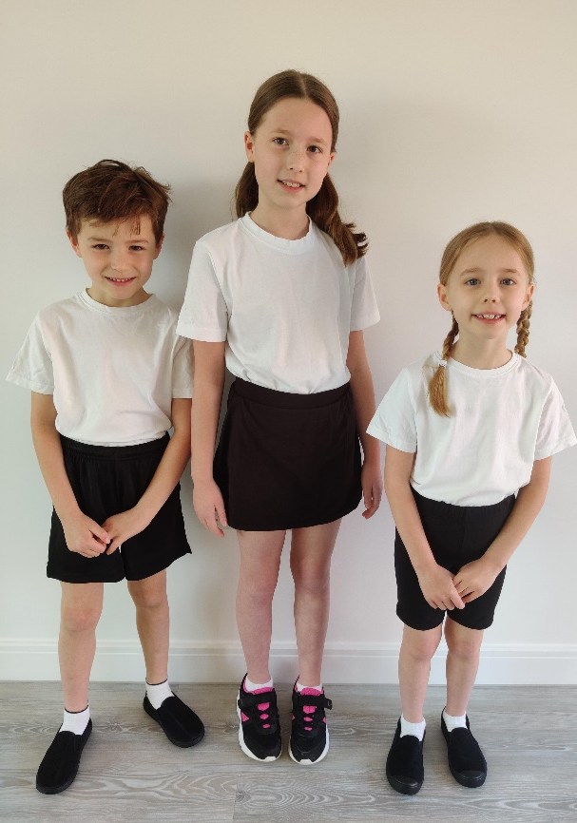
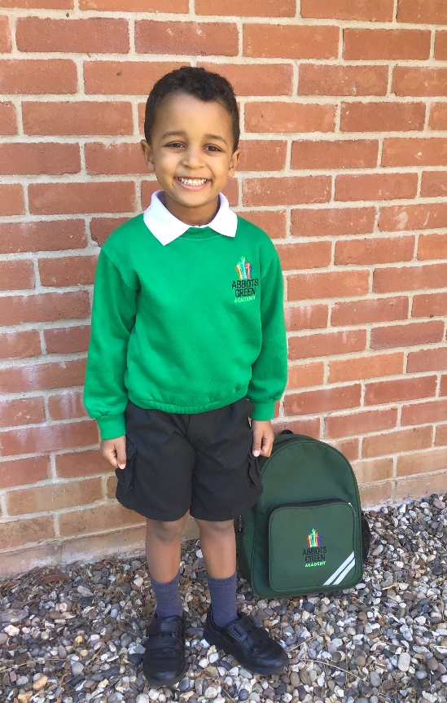
Our uniform at Abbots Green
Notes:
– abbots green sweatshirt, white polo shirt, black grey trousers/skirt, summer dress, school shoes NAMED
PE – white top, black shorts, plimsols, winter kit, NAMED
Children ideally need to be able to dress themselves, organise/put away clothes etc before they start school.
Earrings/No PE kit.
Uniform orders can be made via the school office.
Give deadline for ordering uniform for Sept.
Uniform vouchers (LJ to clarify this with Sue -I can talk about this on night)

Slide 13

Before school
7:45am-8:40am
After School
3:30pm-6pm

Slide 14
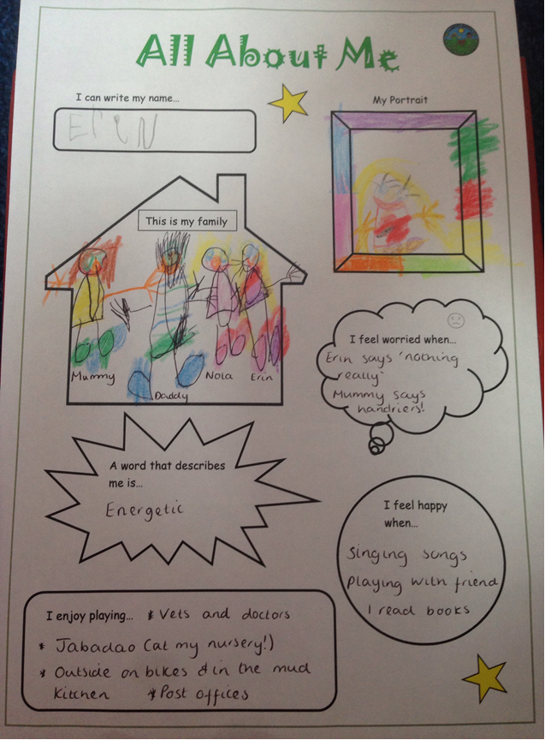
Transition days
At Abbots Green we recognise that a smooth transition from pre-school, nursery or home to school is essential.
We ask you to help your child to complete an ‘All About Me’ sheet so that we can find out as much as we can about your child.
We will ensure that we give you and your child plenty of opportunities to get to know the school, staff and routines before they start school.
Notes:
1)Positive feedback last year – lots of parents said that sessions helped their child settle into school quickly
2)Transition important so that children are at home in their new school environment, can make friends and become familiar with routines such as lining up in morning. 3)Also essential to us when arranging the classes for next year so that children are in the best possible groupings to support them socially and academically.
4)A member of the team will arrange a visits to nurseries/be in touch if your child has not attended preschool.
Please be mindful that these sessions are very popular, for the above reasons and therefore the classrooms are very busy at the beginning of each session with up to 60 children and parents. Please feel free to focus on playing with your child at the first session and then settling them at the second ready to leave them for the Wednesday when they stay for lunch.
Transition sessions make sure that every child can be placed in the class that is ‘right’ for them. We will therefore let you know which class your child is in after the second transition session. They will then spend the Wednesday session in their new class group.
Then on the Thursday there is the opportunity to come and meet your child’s class teacher and discuss any concerns or ask any questions you may have. We also ask that you return the All About Me sheet at this meeting.

Slide 15

Communication
Letters and reply slips
Termly topic updates
Home learning and reading books
Parent partnership sessions
Notes:
Newsletter every Friday is our main means of communication with parents....contains - you will receive this through parentrmail or REQUEST a paper copy. If viewing online the onus is on the parent to do this as we will not send out numerous text messages to remind parents of information. Everything is also on the website.
Homelearning: the more you do at home the better. More information will follow but to begin with it will be supporting your child with their sounds, then onto key words, then reading books ‘please read with your child’. Phonics evening beginning of term.
Maths wallets
Any questions

Slide 16

Parent Partnership
Termly Topic Updates
Parent Partnership Sessions
Parent Forum
Green Tea
FOAG
Home School Agreement
Twitter
School Website

